Slide 1
Running a Product Security Program with Limited Resources
Presented by:
Harold Toomey
President, ISSA North Texas

Slide 2
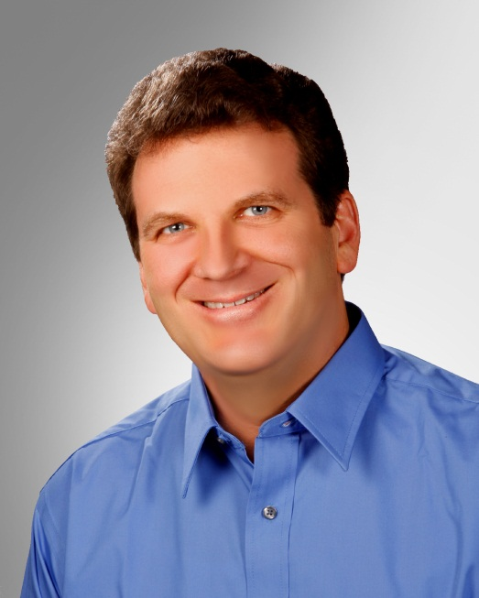
Introduction
President, ISSA North Texas 2013
Day-Job Product Security Roles
Define, build and manage the SDL, policies, processes and PSG program
Create, manage, and mentor the PSC team
Manage PSIRT team
Metrics
Training program
Certification support
Experience
2 Years: Dev. Product Security
2 Years: IT Operational Security
11 Years: Product Management
10 Years: Software Development
CVSS Special Interest Group (SIG)
Harold Toomey
Principal Product
Security Architect

Slide 3
Agenda
What is Product Security?
SDL
People
Process
Technology
Metrics
Wish I Had Known
Q&A
People
Process
Tech- nology

Slide 4
What is Product Security?
Securely developing software before handing it off to IT.
Software / Product Security
Pre-Launch
Dev
Post-Launch
IT
Application Security

Slide 5
What is Product Security? (cont.)
Product Security
Processes, technology, and activities aimed at ensuring that software products do not contain exploitable conditions.
Application Security
Protecting software and the systems that software runs in a post facto manner, only after development is complete.
Quality
(SDLC)
Security
SDL
Privacy
Notes:
What is product Security?
Processes, technology, and activities aimed at ensuring that software products do not contain exploitable conditions.
Secure Code vs. Quality Code
Secured code doesn’t mean quality code
You must know how to write quality code before you write secure code.
A developer can write very secure code that authorizes and authenticates every user transaction, logs the transactions, and cancels out all unwanted requests; however, if that code does not return the expected results, then this very secure code might never see the light of day.
Quality code doesn’t mean secure code
A developer can write efficient code that is easy to maintain and reusable; however, if that code allows an unauthorized user to access the application’s assets, then that code is of no use (Confidentiality, Integrity, and Availability).
Unlike software quality, software security tends to be less subjective. Sensitive information is either exposed or it is not, and there is no second chance of getting it right. The foundation of software applications and the development processes that produce them are based on common best principles of quality code and secure code.
These two attributes complement each other very nicely, and both make the overall software product really great.
The foundation of software applications and the development processes that produce
them are based on common best principles of quality code and secure code.
These two attributes complement each other very nicely, and both make the overall software product
really great.

Slide 6
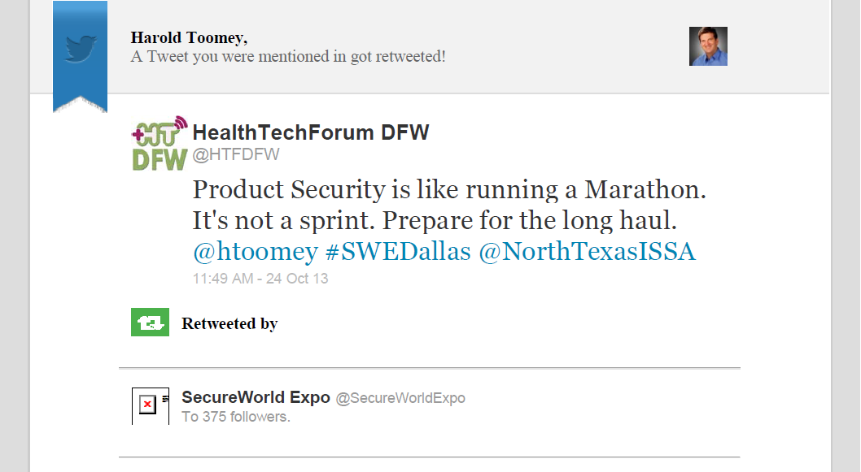
Product Security vs. Marathons

Slide 7
Running Analogy – Marathon Maniac

Slide 8
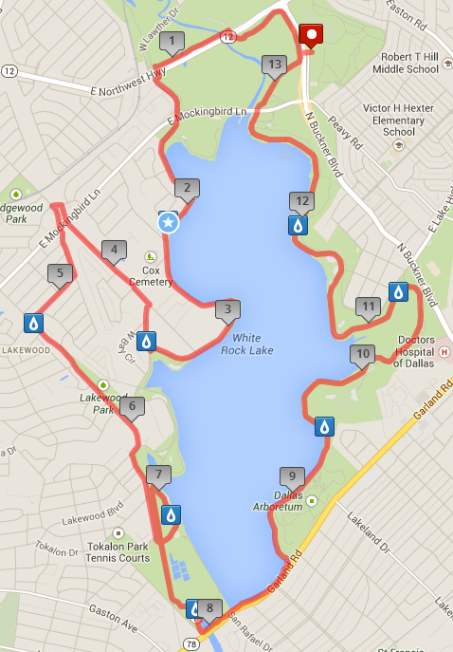
Running Analogy – Course Map

Slide 9
Secure Development Lifecycle (SDL)
0 | 1 | 2 | 3 | 4 | 5
Concept | Planning | Design & Development | Readiness | Release & Launch | Support & Sustain
Security Assessment | Architecture | Design & Development |  | Ship | Post-Release, Legacy, & M&A
S0 | S1 | S2 | S3 | S4 | S5
Product security team is looped in early (Product Security Group & Product Security Champions) Product security team hosts a discovery meeting Product security team creates an SDL project plan (states what further work will be done) Product team initiates a Privacy Impact Assessment (PIA) | S1 Security Plan SDL policy assessment & scoping Threat modeling / architecture security analysis Privacy information gathering and analysis | S2 Security Plan Security test plan composition Static analysis Threat model updating Design security analysis & review Secure coding Privacy implementation assessment | S3 Security Plan Security test case execution Static analysis Dynamic analysis Fuzz testing Manual code review Privacy validation and remediation | S4 Security Plan Final security review Vulnerability scan Penetration test Open source licensing review Final privacy review | External vulnerability disclosure response (PSIRT) Reviews by 3rd party service contractors Post-release certifications Internal review for new product combinations or cloud deployment Security architectural reviews & tool-based assessments of legacy and M&A products
Notes:
SDLs should not be confused with the software development lifecycle (SDLC). The SDL methodology, as the name suggests, is really aimed at developing secure software, not necessarily quality software.
The goals of SDL are twofold:
Reduce the number of security vulnerabilities and privacy problems
Reduce the severity of the vulnerabilities that remain
The elements of an SDL are typically very adaptive and are incorporated into the software development lifecycle for an organization, at which point the process is then called a secure software development lifecycle (SSDLC).

Slide 10
Other Popular SDLs
http://www.microsoft.com/security/sdl
ISO/IEC 27034-1:2011:
Information technology -- Security techniques -- Application security -- Part 1: Overview and concepts. SDL. Draft as of Oct. 2013.
Notes:
1) Microsoft SDL (Security Development Lifecycle)
The SDL is a set of principles and best-practices published by Microsoft that suggest how to develop secure applications
The goals of the SDL are to:
To reduce the number of vulnerabilities in the app before it ships
To reduce the severity of any undiscovered security issues
The SDL incorporates security activities into each stage of dev.
www.microsoft.com/security/sdl

Slide 11
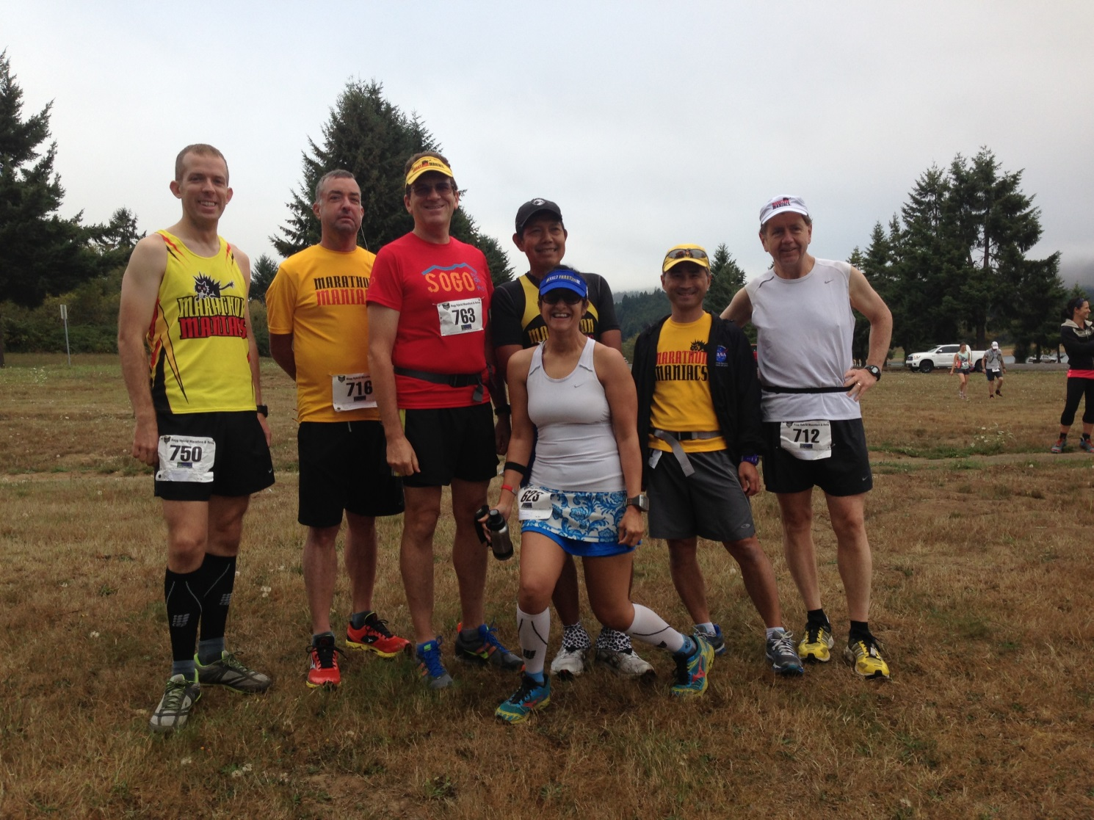
Running Analogy – Types of Runners

Slide 12
People
IT (CSO) vs. Dev. (R&D)
# Security FTEs per n Developers
Full-Time vs. 10% - 20%
Empowered vs. Recommenders
Developers/Architects vs. IT Security Experts
Quality vs. Quantity
People

Slide 13
Product Security Organization
Executive VP R&D (Dev.)
VP Quality
Sr. Director, Product Security Group (PSG) x1
Principal Product Security Architects (PSA) x2
Product Security Champions (PSC) x46
Extended Team
IT Security
Quality (QA)
Public Relations
Technical Support
Dev. Training

Slide 14
Product Security Champion Staffing
BU A | BU B | BU C | BU D | BU E
BU | BU | BU | BU | BU
Product A1 | Product B1 | Product C1 | Product D1 | Product E1
Product A2 | Product B2 | Product C2 | Product D2 | Product E2
Product A3 | Product B3 | Product C3 | Product D3 | Product E3
Product A4 | Product B4 | Product C4 | Product D4 | Product E4
Product A5 | Product B5 | Product C5 | Product D5 | Product E5
Product A6 | Product B6 | Product C6 | Product D6 | Product E6
Product A7 | Product B7 | Product C7 | Product D7 | Product E7
Product A8 | Product B8 | Product C8 | Product D8 | Product E8
 | Product B9 | Product C9 | Product D9 | Product E9
 | Product B10 |  | Product D10 | Product E10
 | Product B11 |  | Product D11 | Product E11
KEY: | Product B12 |  | Product D12 | Product E12
Red – No PSC | Product B13 |  | Product D13 | Product E13
Yellow – BU PSC Only | Product B14 |  | Product D14 | Product E14
Green – Product Line PSC | Product B15 | Other | Product D15 | Product E15
 | Product B16 | Product F1 | Product D16 | Product E16
 | Product B17 | Product F2 | Product D17

Slide 15
Product Security Champion Qualifications
A minimum of 3-5 years software development experience (architects preferred)
A passion for or background in software security
Approved by the BU General Manager & BU PSC Lead
Dedicate 10% - 20% of their time doing product security tasks
Time to be trained in software security, tools, plans, and processes
Must not only know how to develop (build) software, but also know how to deconstruct it (take it apart) while “thinking like a hacker”

Slide 16
Product Security Champion Responsibilities
Enforce the SDL: Assist the PSG in assuring the security tenants of confidentiality, integrity, availability, and privacy are adhered to
Reviews: Assist the PSG’s software security architects in conducting architecture security analysis, reviews, and threat modeling
Escalations: Assist with Security Bulletins and patches for externally disclosed vulnerabilities (PSIRT)
Tools Expert: e.g. static, dynamic – which includes fuzzing, within each product development team, and/or business unit (BU)
Collocated: Be the eyes, ears, and advocate of the PSG within each product dev. team / BU
Attend Meetings: Participate in weekly Admin / Technical meetings as a team

Slide 17
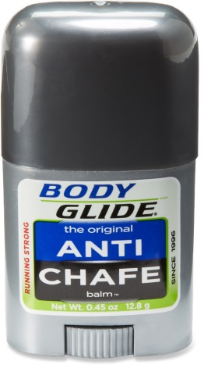
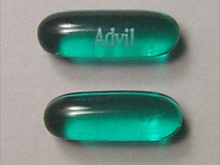
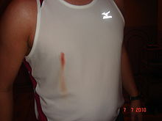
Running Analogy – Process
Weather
Course Review
Countermeasures
Advil
Bandages
Body Glide
Mustard
Recording
Pictures
Facebook Album

Slide 18
Process
Process
Architecture Security Reviews
PSIRT
Training Program
Policies
M&A Code Reviews
Certifications and Redaction
Programmatic and Admin

Slide 19
You Made Your Bed, Now Sleep In It
PSIRT
Incident
Attack / Exploit
Vulnerability
Error
Defect
Insecure Coding
Security
Reviews

Slide 20
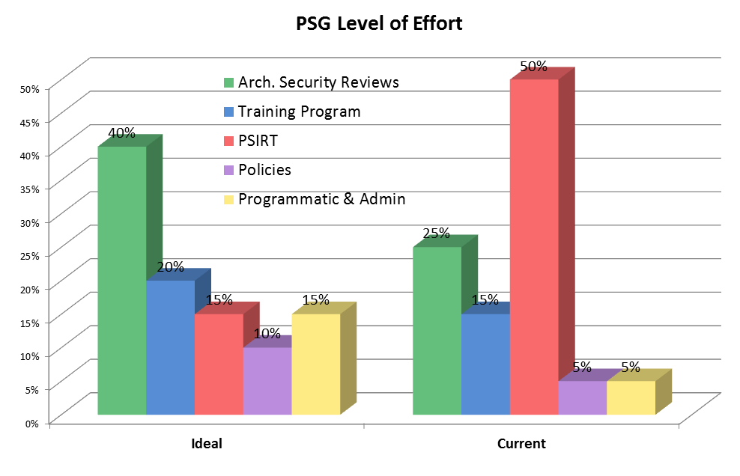
Level of Effort
New Headcount Justification?

Slide 21
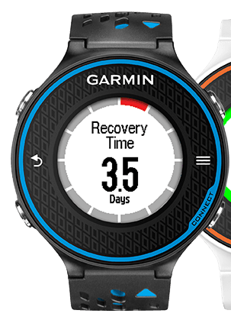
Running Analogy – Technology
Monitoring
Heart Rate
Muscle Fatigue
Breathing
Timing

Slide 22
Technology (Tools)
Critical methods used to ensure the development of secure code within an SDL:
Tech
Static Analysis:
A method of examining software at compile time, reporting potential defects
Dynamic Analysis:
A method of examining software at runtime, by executing the code over multiple test cases
Fuzz Testing:
Providing unexpected, invalid, or random data to an application with the intention of triggering a bug

Slide 23
Technology (cont.)
Free
Costs $$$
/analyze (Code Analysis) flag
Notes:
39 free security software tools
http://www.networkworld.com/news/2010/111510-free-security.html
Microsoft Visual C++
/analyze (Code Analysis)This compiler option activates code analysis that reports potential security issues such as buffer overrun, un-initialized memory, null pointer dereferencing, and memory leaks. By default, this option is off. For more information, see Code Analysis for C/C++ Overview.

Slide 24
Running Analogy – Goals & Metrics
Distance
½ Marathon
Marathon
Marathon Maniacs
50 States
50M
100K
100M
Triathlon
Speed
6:00 Marathon Limit (US)
5:00 Marathon Limit (EU)
4:00 Marathon (25%)
3:30 Boston Qualifier
2:00 Marathon Glass Ceiling (2:03:23)
Notes:
The IAAF world record for men, subject to ratification, is 2:03:23, set by Wilson Kipsang of Kenya on September 29, 2013 at the Berlin Marathon.

Slide 25
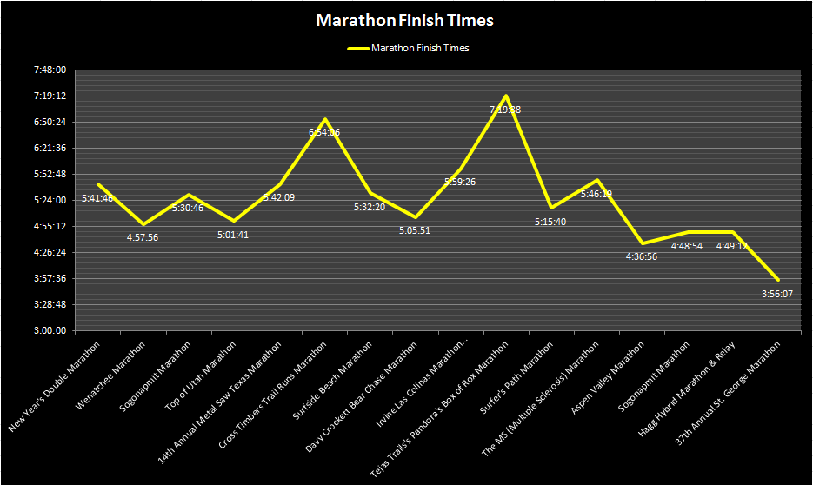
Running Analogy – Metrics

Slide 26
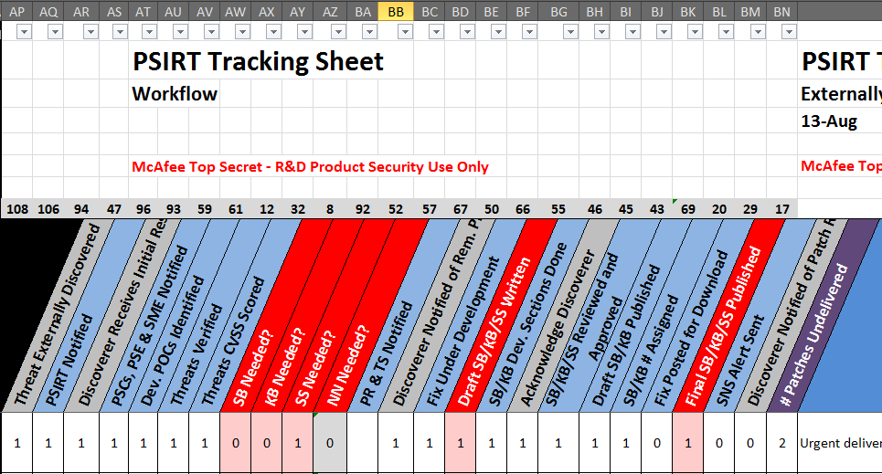
Metrics using MS Office
Notes:
Metrics must be designed to drive positive change
Metric reports must adapt to the audience
Executive Management (CPOR)
EVP of Engineering & Staff
VP Quality (our boss)
Product Security Champions (our virtual team)
Metric creation should be automated
Currently automated in a spreadsheet
Static analysis data collection partially automated
Metric data entry and access should be distributed
Was tracked in PPT 2 years ago
Outgrowing the XLS
Looking for a Web-based database to remove bottleneck
Must constantly adapt and refine
Leverage best practices (company, standards, etc.)

Slide 27
PSIRT Tracking Database
Status
In Queue
In Progress
On Hold
Patch Ready
Completed
Not Needed
Unique ID
SB / KB / SS
References
Bugzilla #
CVE # (vulnerability)
CWE # (weakness)
CAPEC # (attack)
CERT/CC #, Other ID
Name
Product
BU
Priority
Criticality
CVSS Score
Time
Date Reported
Estimated Completion Date
Fix Due Date
Date Completed
Work Days to Complete
Effort
# Vulnerabilities
Severity
Probability
# of Customers Impacted
Damage to Customers Score
Publicly Disclosed?
Media Interest Expected?
Media Interest Actual
Bugzilla Only
Zero Day or Malicious Discoverer?
3rd Party Vulnerability?
Extra Effort (days)
Estimated Effort (days)
People
Dev. Team POC(s)
Discoverer
PSG POC
PSC Product Line POC
PSC BU Lead POC
PSE POC
Tier-III SME POC
Dev POC
QA POC
PM POC
PgM POC
Workflow
Notes

Slide 28
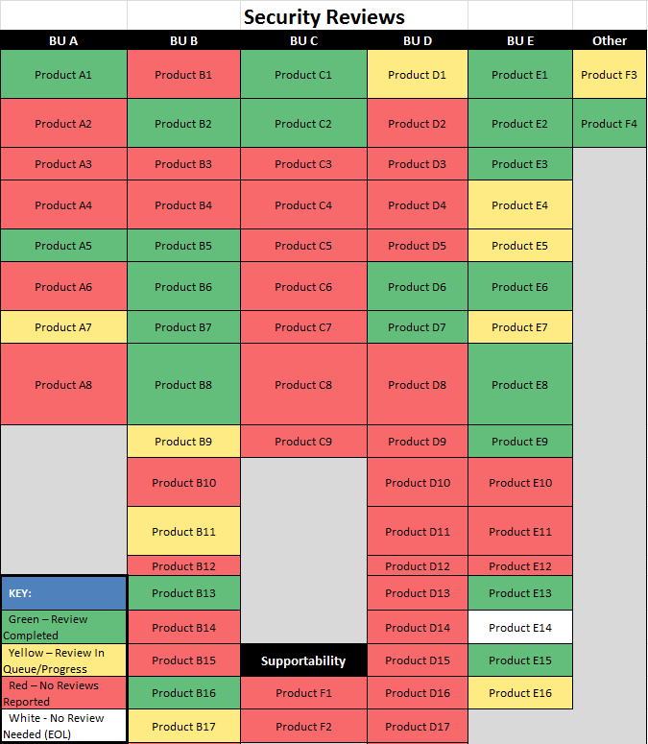
Metrics – Heat Maps (cont.)

Slide 29
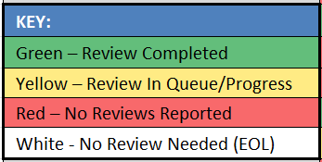
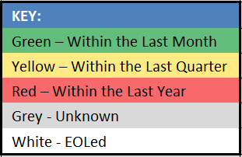
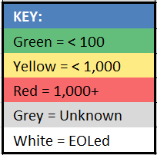
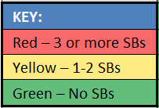
Metrics – Heat Maps
Average Days Since Last Static Analysis Run
Outstanding
Static
Analysis
Defects
Security Reviews
Security Bulletins

Slide 30
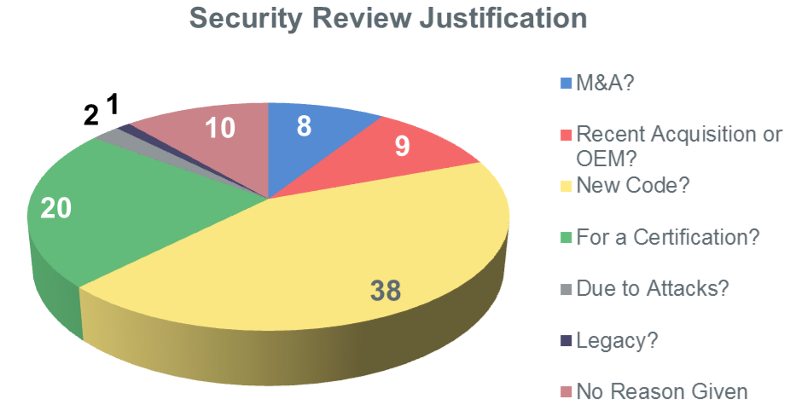
Metrics – Reason for Security Reviews

Slide 31
Harold’s Product Security Metrics Maturity Model
Level of Maturity
Partially automated
Multiple access
Detailed level
Patterns are apparent
PPT visuals
Key policies
Internally published policies
Mostly manual
Inefficient
Single access
High-level only
Stand-alone
Incomplete coverage
Key policies
Limited budget
X
Fully automated
Highly efficient
Real-time dashboard
All audience levels
Full coverage
Integrated
Externally published policies
Fully budgeted
All manual
Very inefficient
Incomplete
Immeasurable
Limited coverage
No policy
Awareness
No budget
Phase
None Initial Basic Acceptable Mature

Slide 32
What Makes This Program So Lean?
Core PSG group consists of a minimum of 3 people
Sr. Director (Prior CSO)
Security Review Expert (PSA)
PSIRT / Program Manager (PSA)
Extended team is from co-located architects (46+) giving 10%-20% of their time, as opposed to having a core team of 20+ full-time PSAs (typical)
SDL includes PSIRT, which is unusual in this industry
Budget
PSC get their travel budget from their BUs, not the PSG
Cost of security tools and 3rd party reviews included in combined Dev. BU budgets
Leverage free / open source tools

Slide 33
Wish I Had Known (Tips)
Before purchasing and deploying in IT, ask 3rd party software providers about their SDL
If they don’t have one, then big red flag
Running a PSG Team
New PSCs must get upper management approval (GM)
Training vs. Mentoring
Bi-weekly Business vs. Technical Meetings
2x weekly PSG Staff Meetings (2 hours each)
Must have published policies
SDL
PSIRT & Security Bulletin Templates

Slide 34
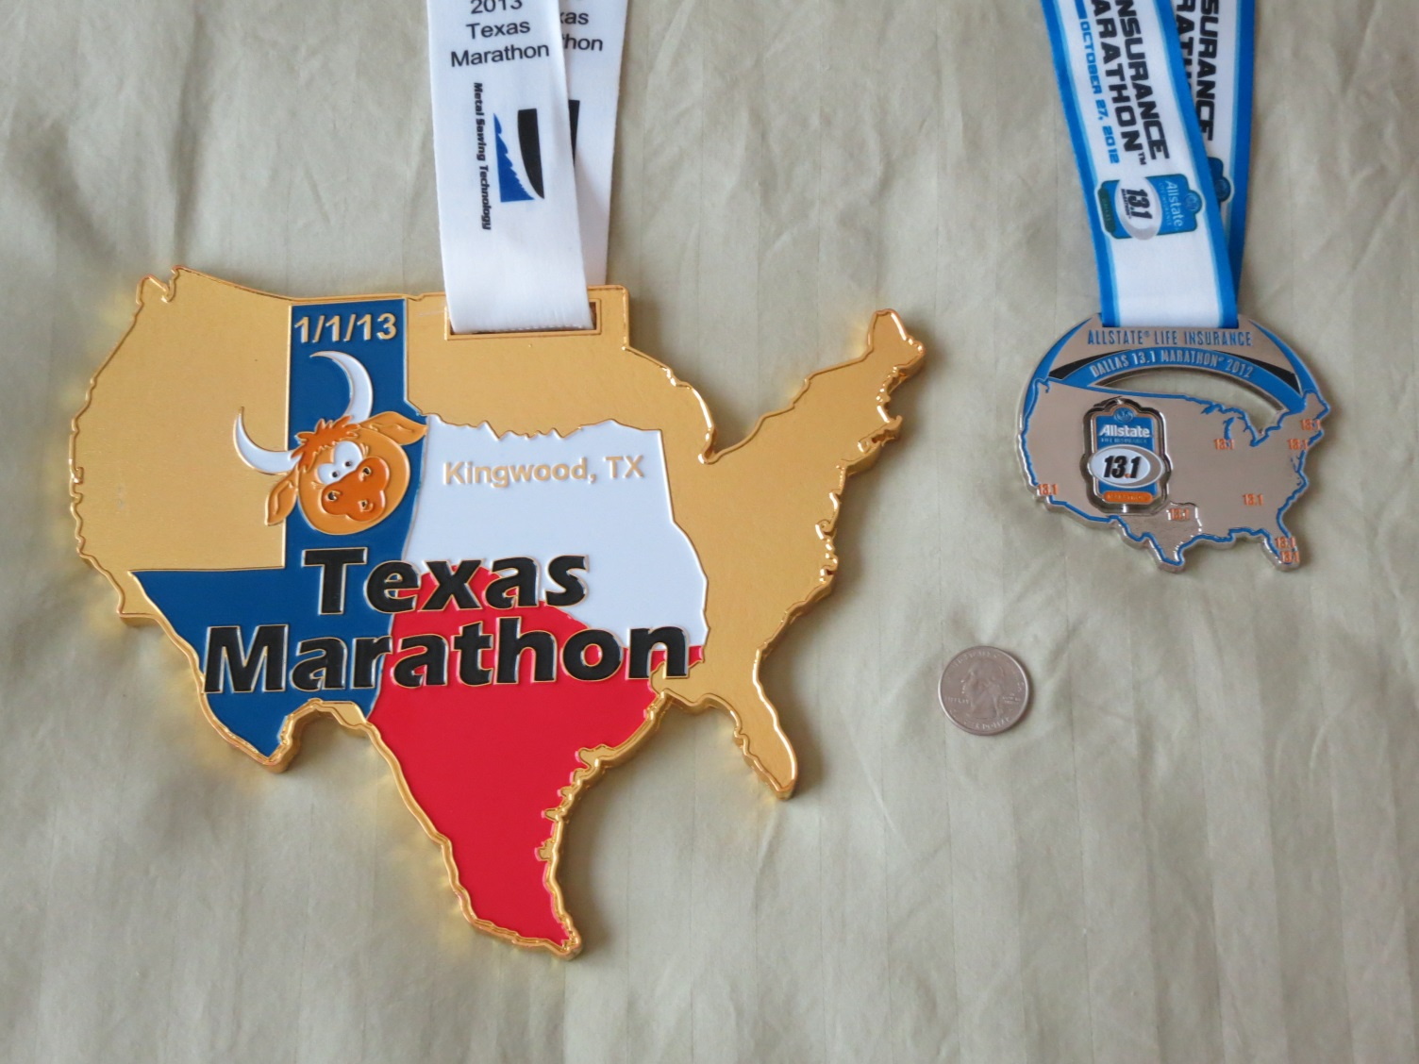
Running Analogy – The Reward

Slide 35
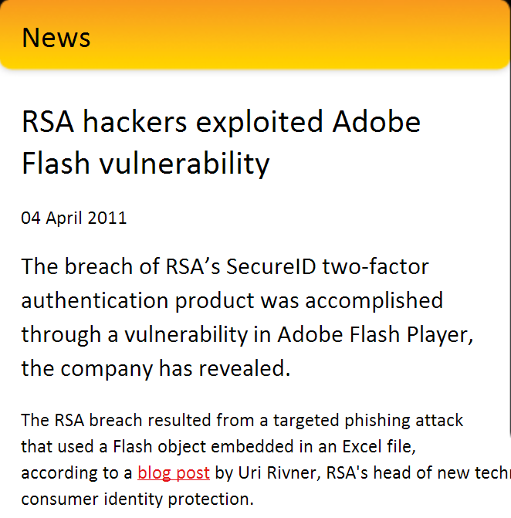
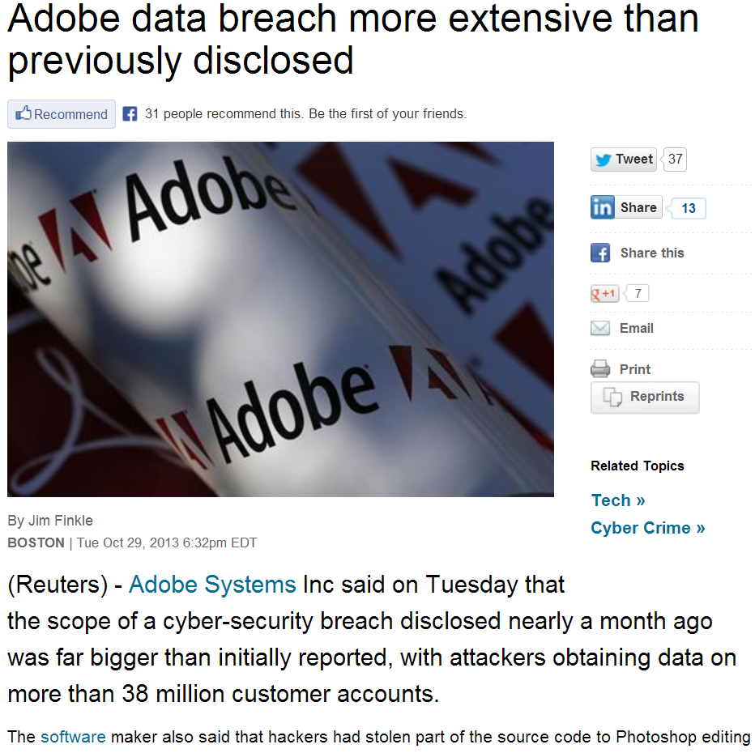
The Punishment Without …
Notes:
Adobe data breach more extensive than previously disclosed
http://www.reuters.com/article/2013/10/29/us-adobe-cyberattack-idUSBRE99S1DJ20131029

Slide 36
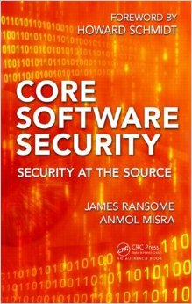
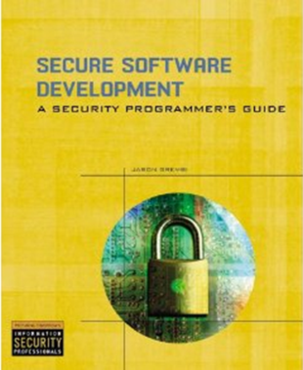
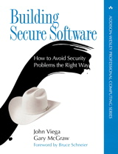
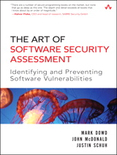
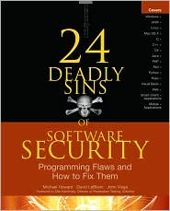
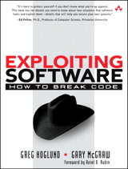
Recommended Reading List
Security Development Lifecycle
Think Like a Hacker and Adversary

Slide 37
Q & A
Harold Toomey
President, ISSA North Texas 2013
President@NorthTexas.ISSA.org
Harold@Toomey.org
(801) 830-9987

